Slide 1
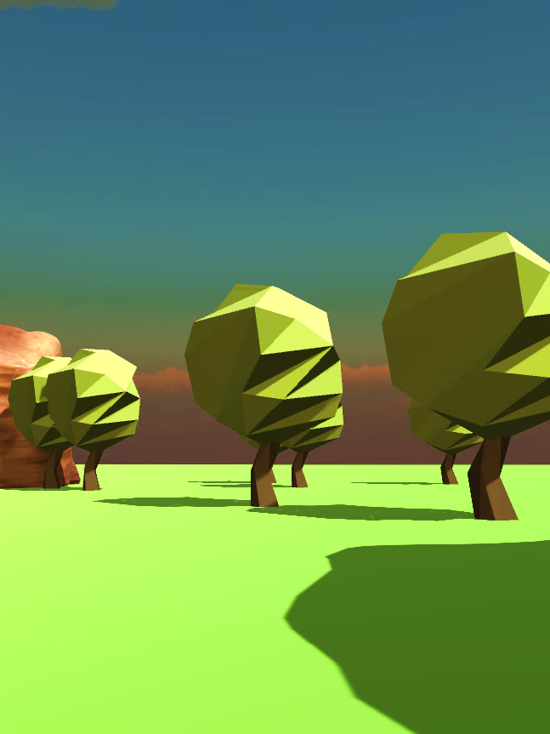
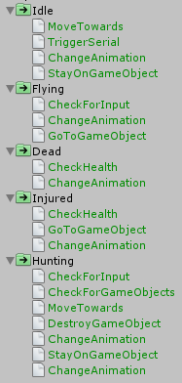
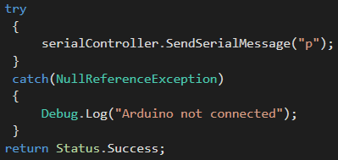
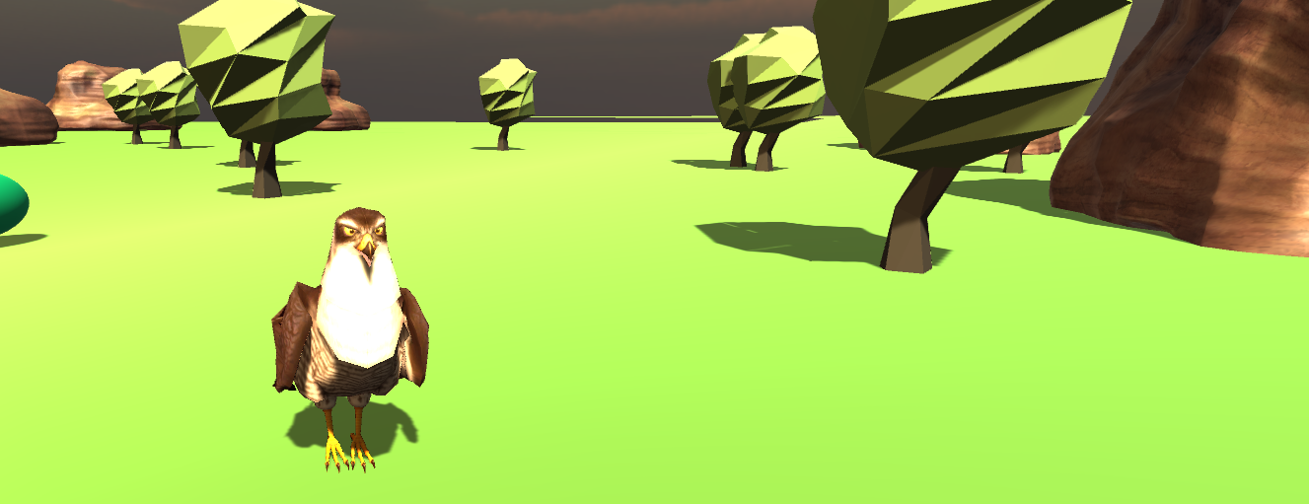

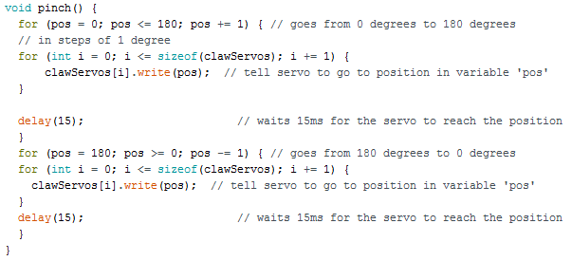
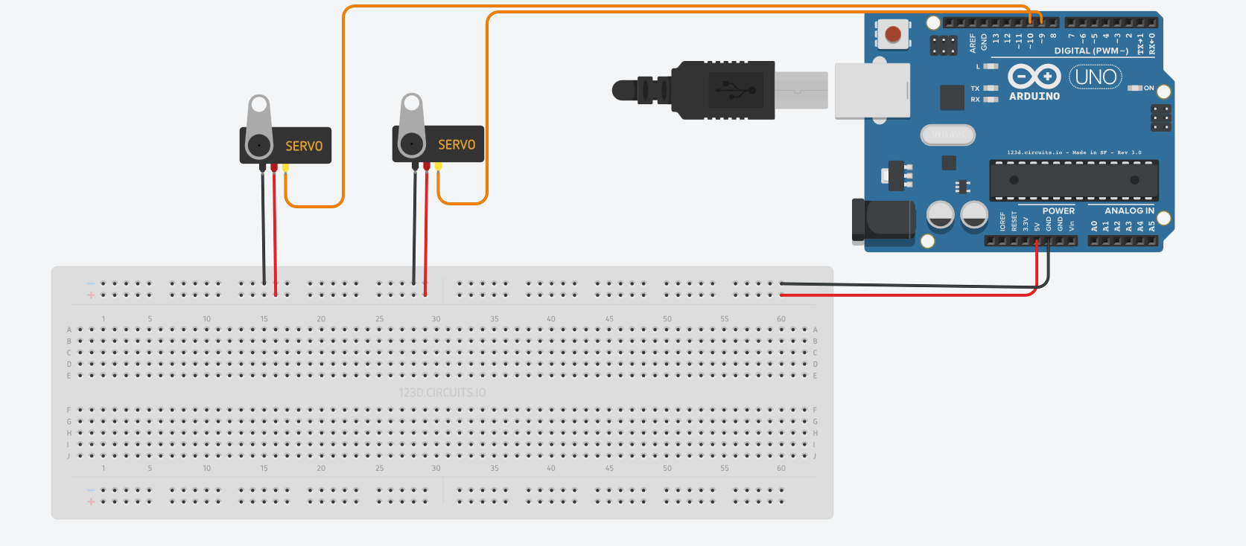
Companion AI & Arduino Accessory
Both of the components are integrated into the COMP240 game. The companion AI controls a falcon that the player can interact with and direct.
Companion AI:
The image on the left shows the branches in the behaviour tree and all the leaf nodes used.
The companion AI is for the falcon companion in the game. It can interact with both the environment and the player.
The player can issue commands through either the keyboard or Vive controller depending on whether they’re playing the VR or non-VR version of the game.
This code is for checking whether the player has used the Vive controller.
Pathfinding is done through the use of Unity navmeshes. These are used to make it hunt and to return to the player. Navmesh obstacles prevent the falcon from flying through objects or the environment.
The code below is the leaf node for triggering the Arduino. It checks whether the Arduino is plugged in then sends a serial message.
The behaviour tree determines what behaviour the falcon should be doing and which animation state it should be in. Branch changes occur when the player provides input of the falcon’s health drops below certain thresholds.
Arduino Accessory:
The accessory is triggered by the GoToPlayer branch of the behaviour tree. Once the falcon reaches the player it sends a ‘P’ through a serial connection to the Arduino which results in the pinch function being called and the servo is moved to simulate the falcon landing on the players arm.
Above is a segment of the code that rotates the servo to move the claw. The prototype only uses one claw but the code uses an array allowing for multiple servos in the final version
The diagram on the right shows the setup of the Arduino and servos. The final version would be more compact and ideally use Bluetooth and a battery pack to make it wireless.

